Slide 1
Senior Design 1
Matthew Munoz, Matthew Nieves
Jinfeng Ouyang, Tajwar Rahman

Slide 2
Team Name: DeepMinds
Inspired by the concept of deep learning and mimicking the human brain's structure and function through artificial neural networks.

Slide 3
Roles:
Matthew Munoz - Team Leader
Matthew Nieves - System Savvy
Jinfeng Ouyang - Quality Assurance
Tajwar Rahman - Tech Smith

Slide 4
Matthew Munoz
Team Leader
Experience leading teams in both class and real world settings
Experience delivering and commission projects on-time and on budget
Personal Git: MattMunoz

Slide 5
Matthew Nieves
Systems Savvy
Experience navigating design and testing phases of circuit design projects and translating technical ideas into clear documentation.
Experience with identifying and mitigating project risks such as technical complexity.
Personal Git: Nieves350

Slide 6
Jinfeng Ouyang
Quality Assurance
Experienced analytical skills coupe with enthusiasm to make sure products meet quality standards.
Paying keen attentions to details and can spot defects or quality issues quickly.
Personal Git: ellis5161

Slide 7
Tajwar Rahman
Techsmith
Expertise in frontend, backend, mobile, cloud, and machine learning
Worked in startups and corporate companies where I have delivered impactful technological solutions
Personal Git: thetajwar2003

Slide 8
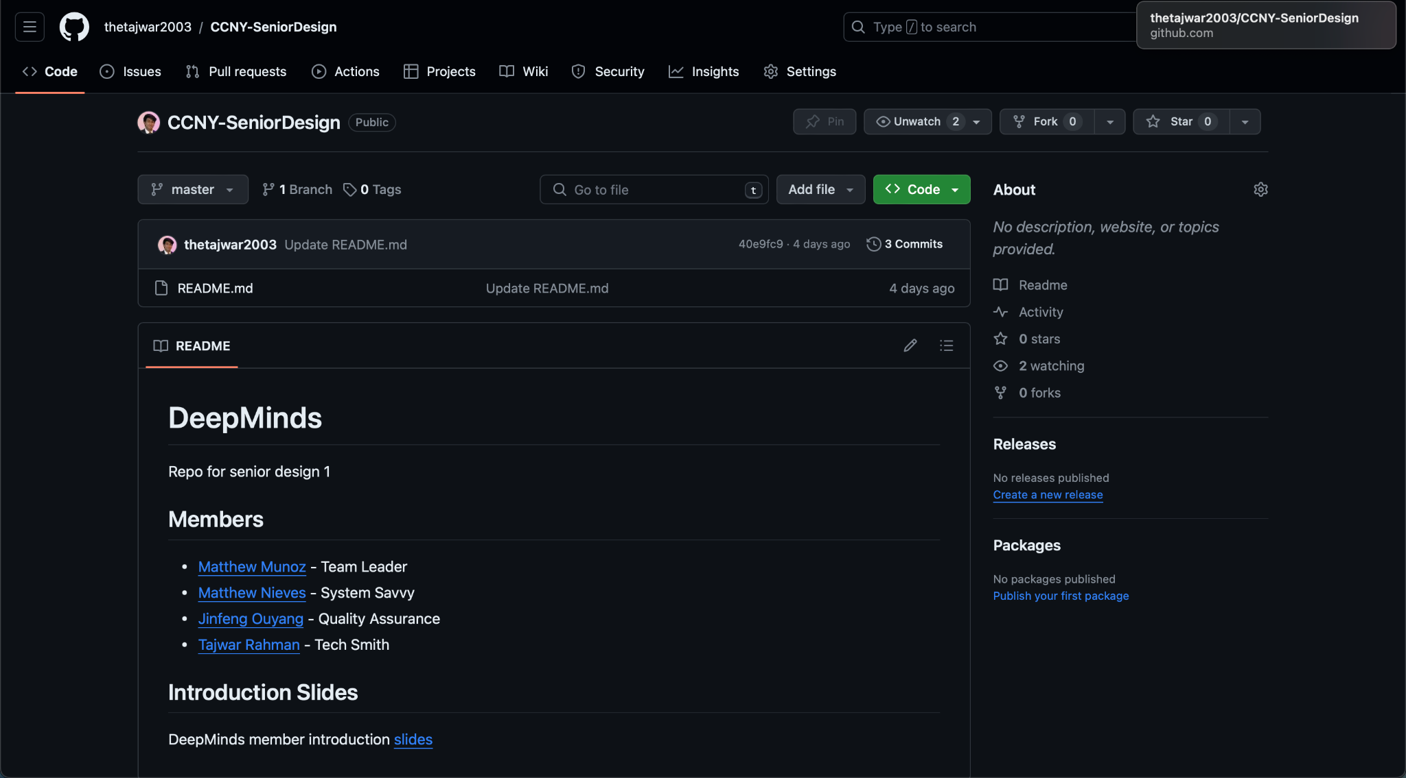
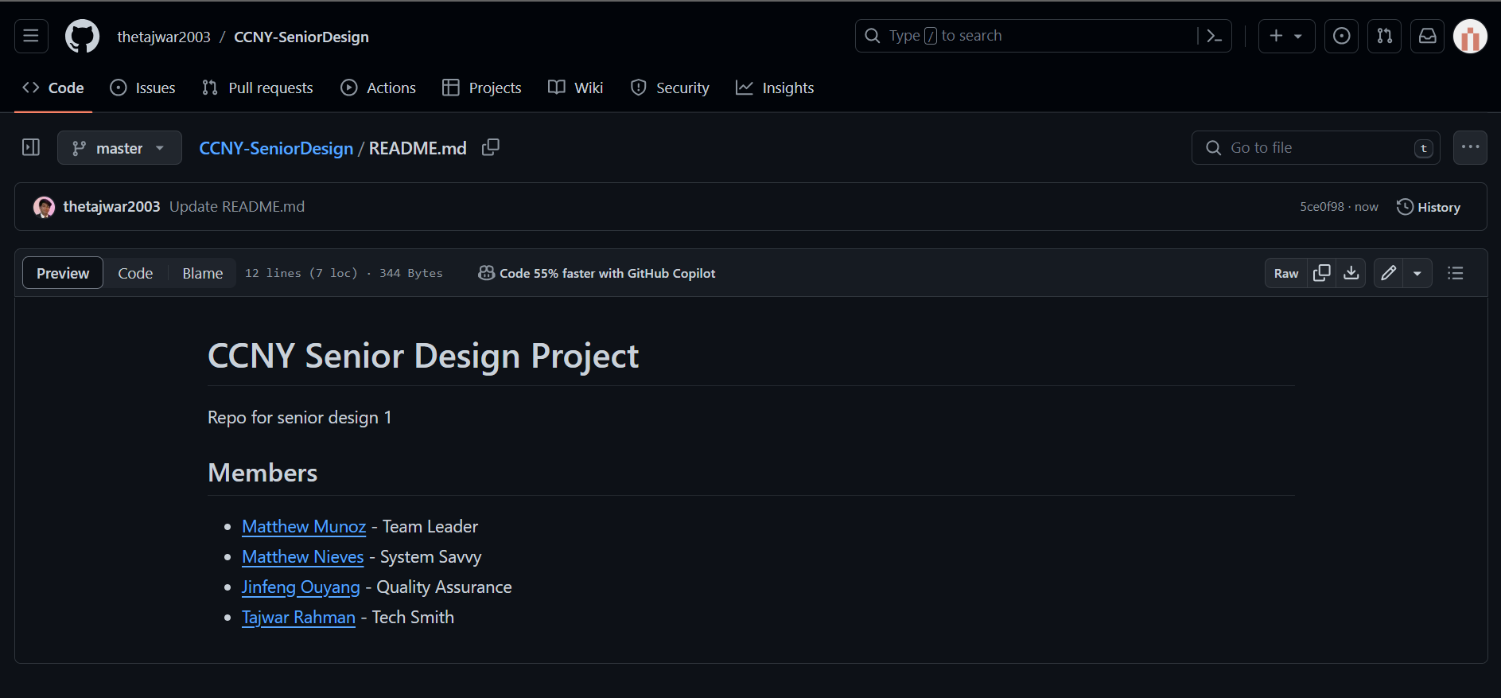
Git:

